Slide 2
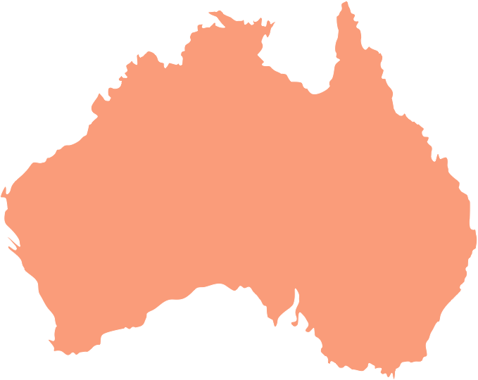
World maps

Slide 3
World

Slide 4
Europe

Slide 5
France

Slide 6
Ile de France

Slide 7
Asia

Slide 8
Africa

Slide 9
America

Slide 10
United States

Slide 11
North America

Slide 12
South America

Slide 13
Australia

