Slide 1
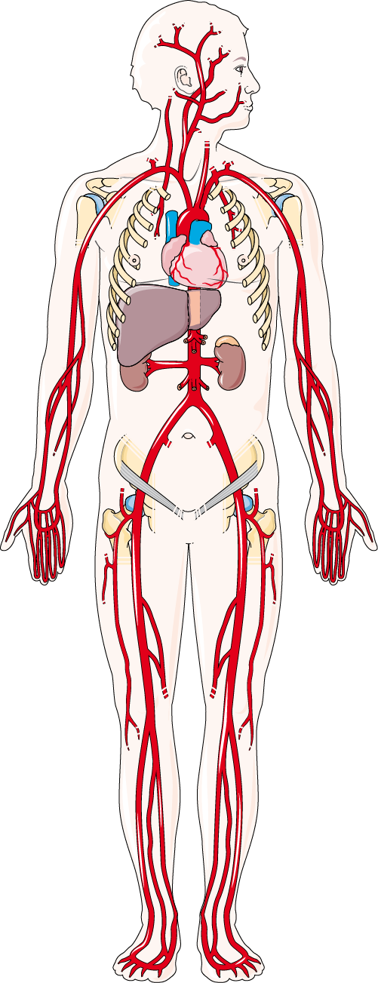
ARTERIAL SYSTEM
The arterial circulation transports oxygenated blood from the heart to the organs, ensuring an essential supply of oxygen and nutrients for cellular function.
EXTERNAL CAROTID
INTERNAL CAROTID
SUBCLAVIAN
AXILLARY
BRACHIOCEPHALIC
AORTIC ARCH
CELIAC TRUNK
BRACHIAL
SUPERIOR MESENTERIC
RADIAL
ULNA
COMMON ILIAC
FEMORAL
ANT. AND POST. TIBIAL
POPLITEAL

