Slide 1
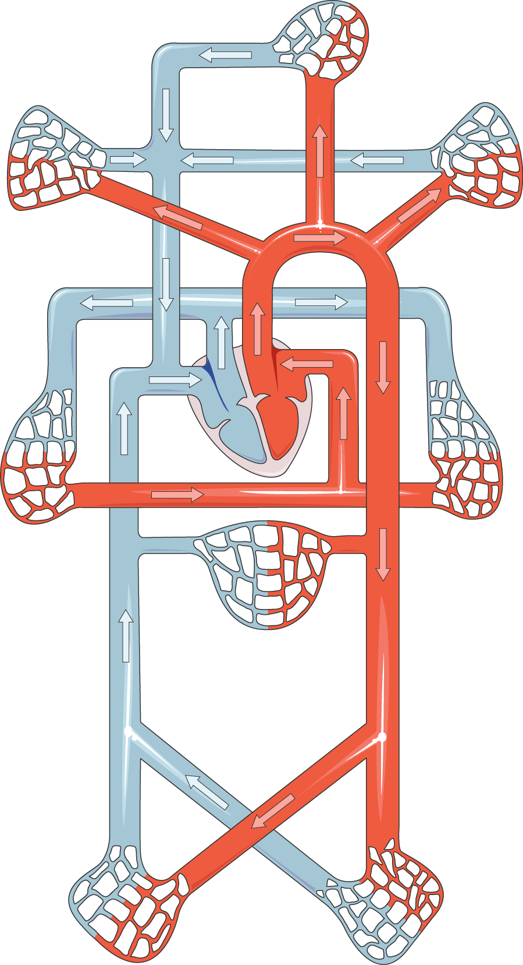
BLOOD SYSTEM
The circulatory system transports nutrients, oxygen, and waste throughout the body.
HEAD AND BRAIN CAPILLARIES
RIGHT ARM AND SUBCLAVIAN CAPILLARIES
LEFT ARM AND SUBCLAVIAN CAPILLARIES
PULMONARY
ARTERY
AORTA
AORTA
RIGHT LUNGS CAPILLARIES
LEFT LUNGS CAPILLARIES
LIVER AND STOMACH CAPILLARIES
KIDNEY CAPILLARIES

