Slide 1
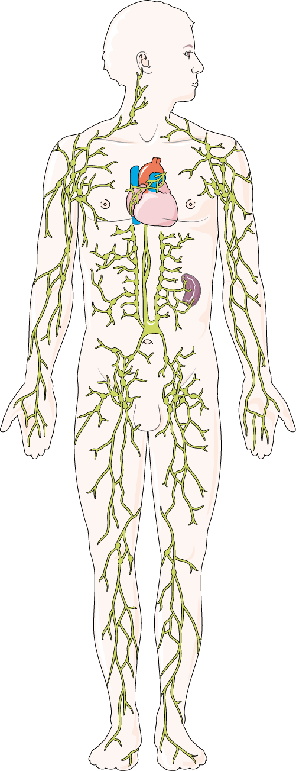
LYMPHATIC
SYSTEM
The lymphatic system transports lymph, a fluid containing infection-fighting white blood cells, throughout the body and removes toxins and waste products.
AXILLARY LYMPH NODES
CERVICAL LYMPH NODES
SPLEEN
CYSTERNA CHYLI
LYMPHATIC OF THE UPPER LIMBS
LUMBAR LYMPH NODES
PELVIC LYMPH NODES
LYMPHATIC OF THE LOWER LIMBS
FEMORAL LYMPH NODES

