Slide 1
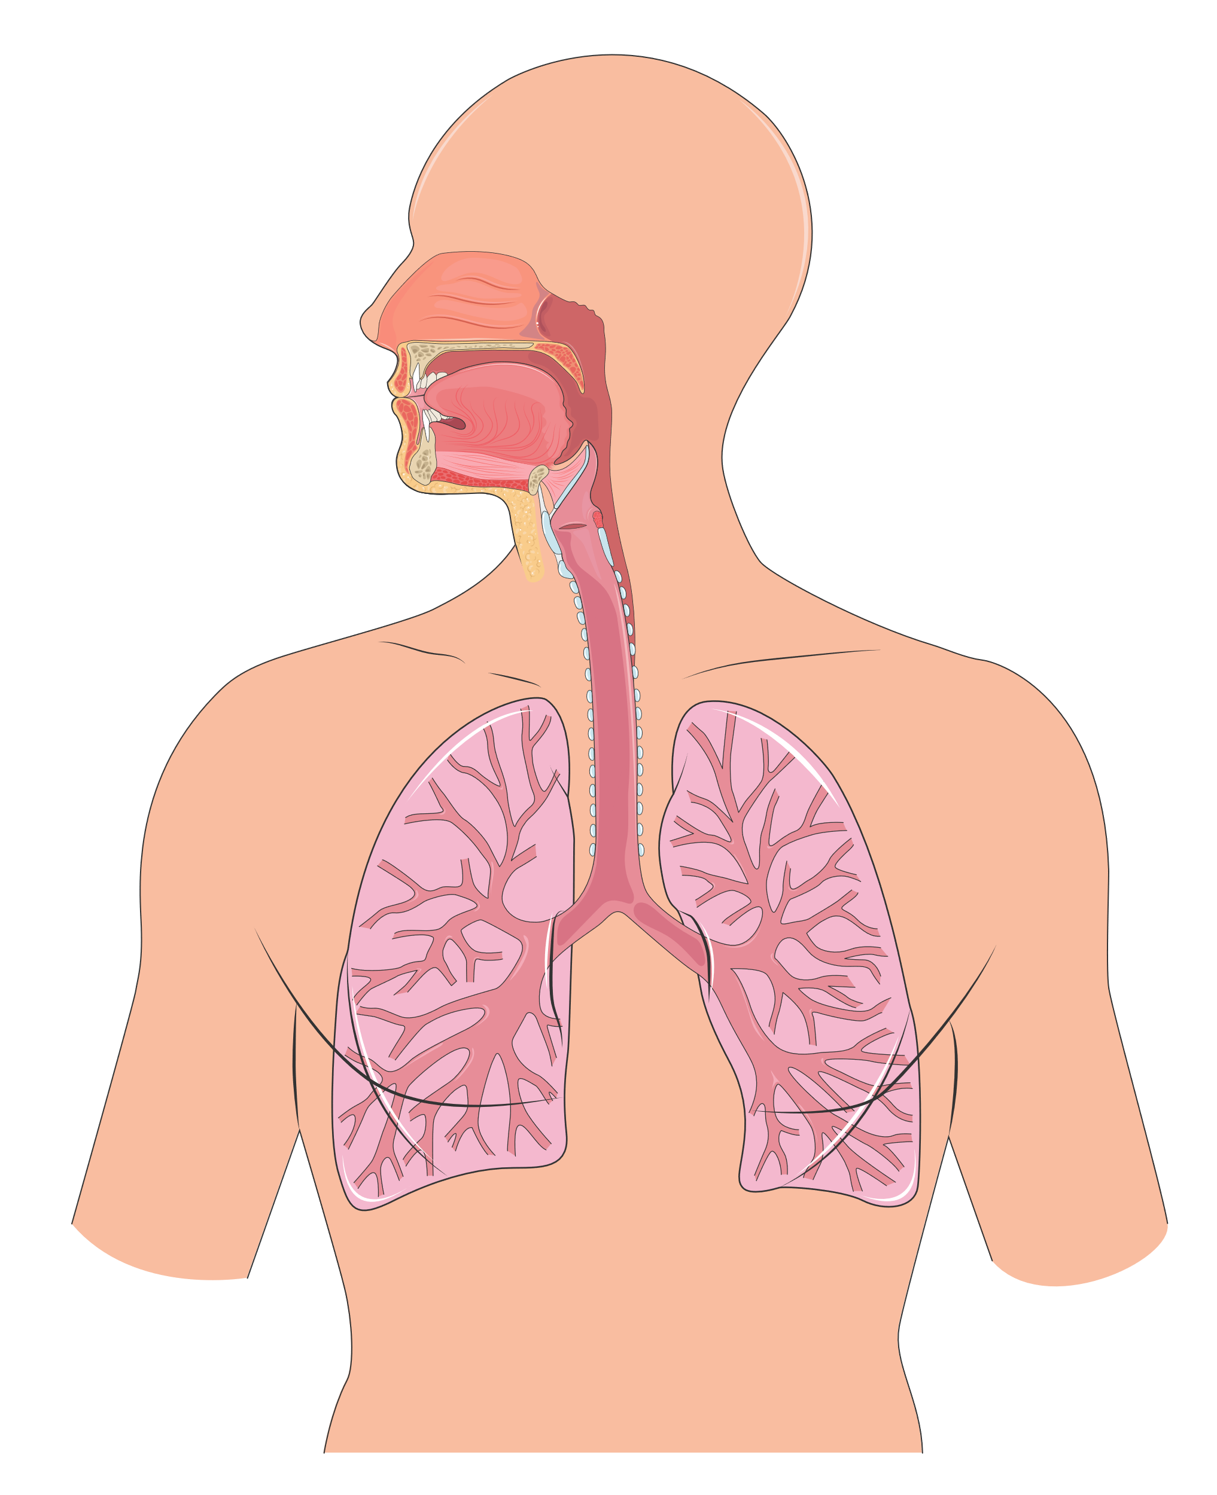
RESPIRATORY
SYSTEM
²
The respiratory system brings oxygen into the body and removes carbon dioxide and other gases.
NOSE
PHARYNX
LARYNX
TRACHEA
BRONCHUS
BRONCHIOLE

