Slide 1
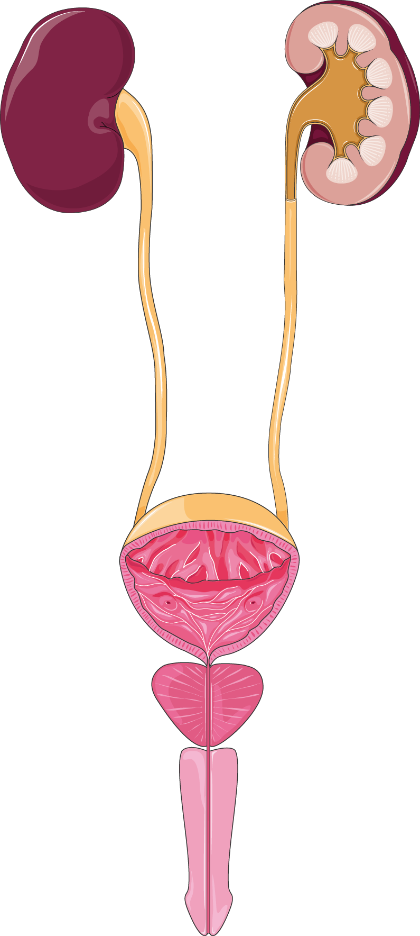
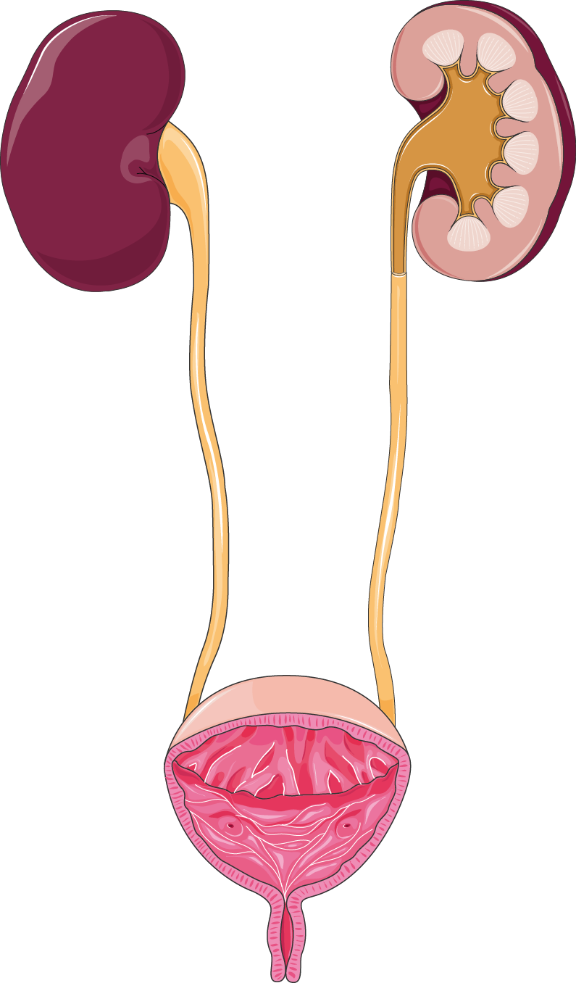
URINARY SYSTEM
The human urinary system removes waste and regulates fluids. Kidneys filter blood and produce urine, which travels to the bladder and is expelled through the urethra.
KIDNEYS
URETERS
BLADDER
PROSTATE
URETHRA

