Slide 1
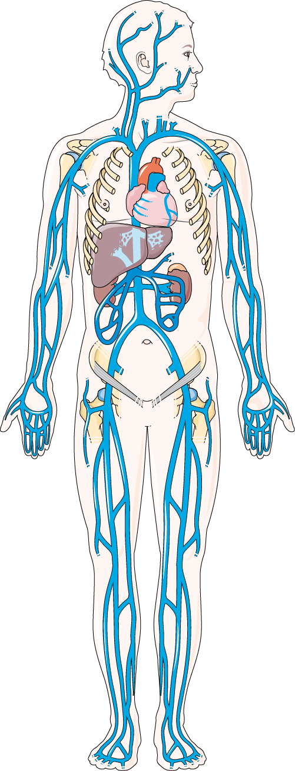
VENOUS SYSTEM
The venous system returns deoxygenated blood from the organs back to the heart, ensuring waste products are removed and blood is reoxygenated.
EXTERNAL JUGULAR
INTERNAL JUGULAR
SUBCLAVIAN
AXILLARY
BRACHIO-CEPHALIC
SUPERIOR VENA CAVA
CEPHALIC
INFERIOR VENA CAVA
BRACHIAL
SUPERIOR MESENTERIC
BASILIC
COMMON ILIAC
FEMORAL
GREAT AND SMALL SAPHENOUS
POPLITEAL

