Slide 1
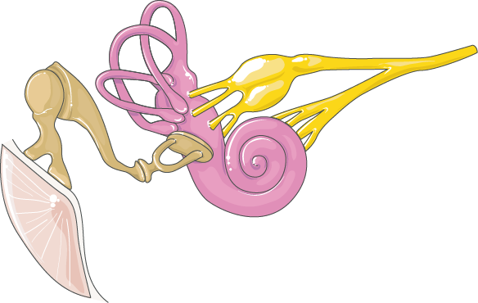
AUDITORY
SYSTEM
The auditory system detects sound waves and converts them into electrical signals that are processed by the brain, enabling hearing and balance.
SEMI-CIRCULAR CANALS
MALLEUS
NERVE FIBERS
INCUS
COCHLEA
EARDRUM
STAPES

