Slide 1
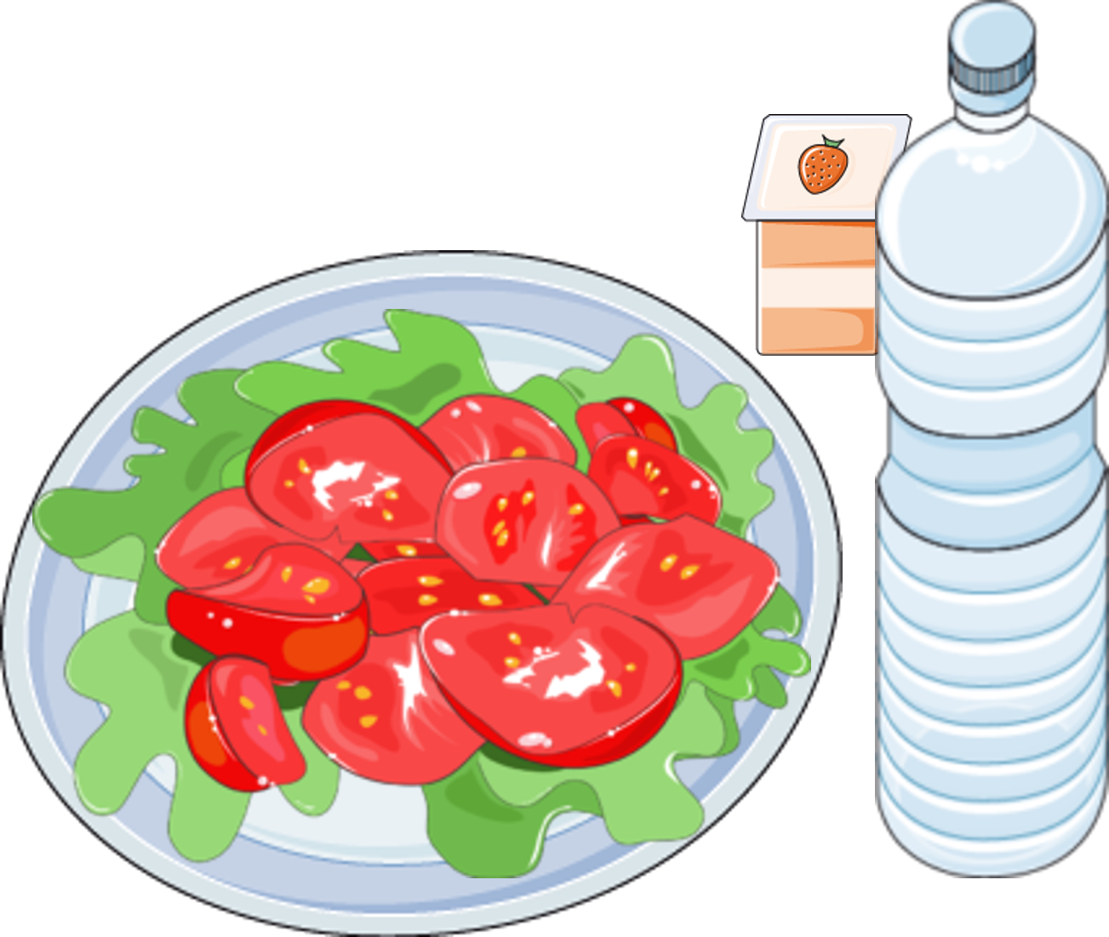
DIABETES
DPP-4 INHIBITORS
DPP-4 inhibitors are medications that help regulate blood sugar in people with type 2 diabetes. They block the DPP-4 enzyme, increasing levels of GLP-1 and GIP hormones, which stimulate insulin production and reduce glucagon release. This helps lower blood sugar levels.
DPP-4 ENZYME
DPP-4 INHIBITORS BLOCK THE
DPP-4 ENZYME
STIMULATES INSULIN SECRETION
GLP-1
FOOD
SMALL INTESTINE
SUPPRESSES GLUCAGON
SECRETION

