Slide 1
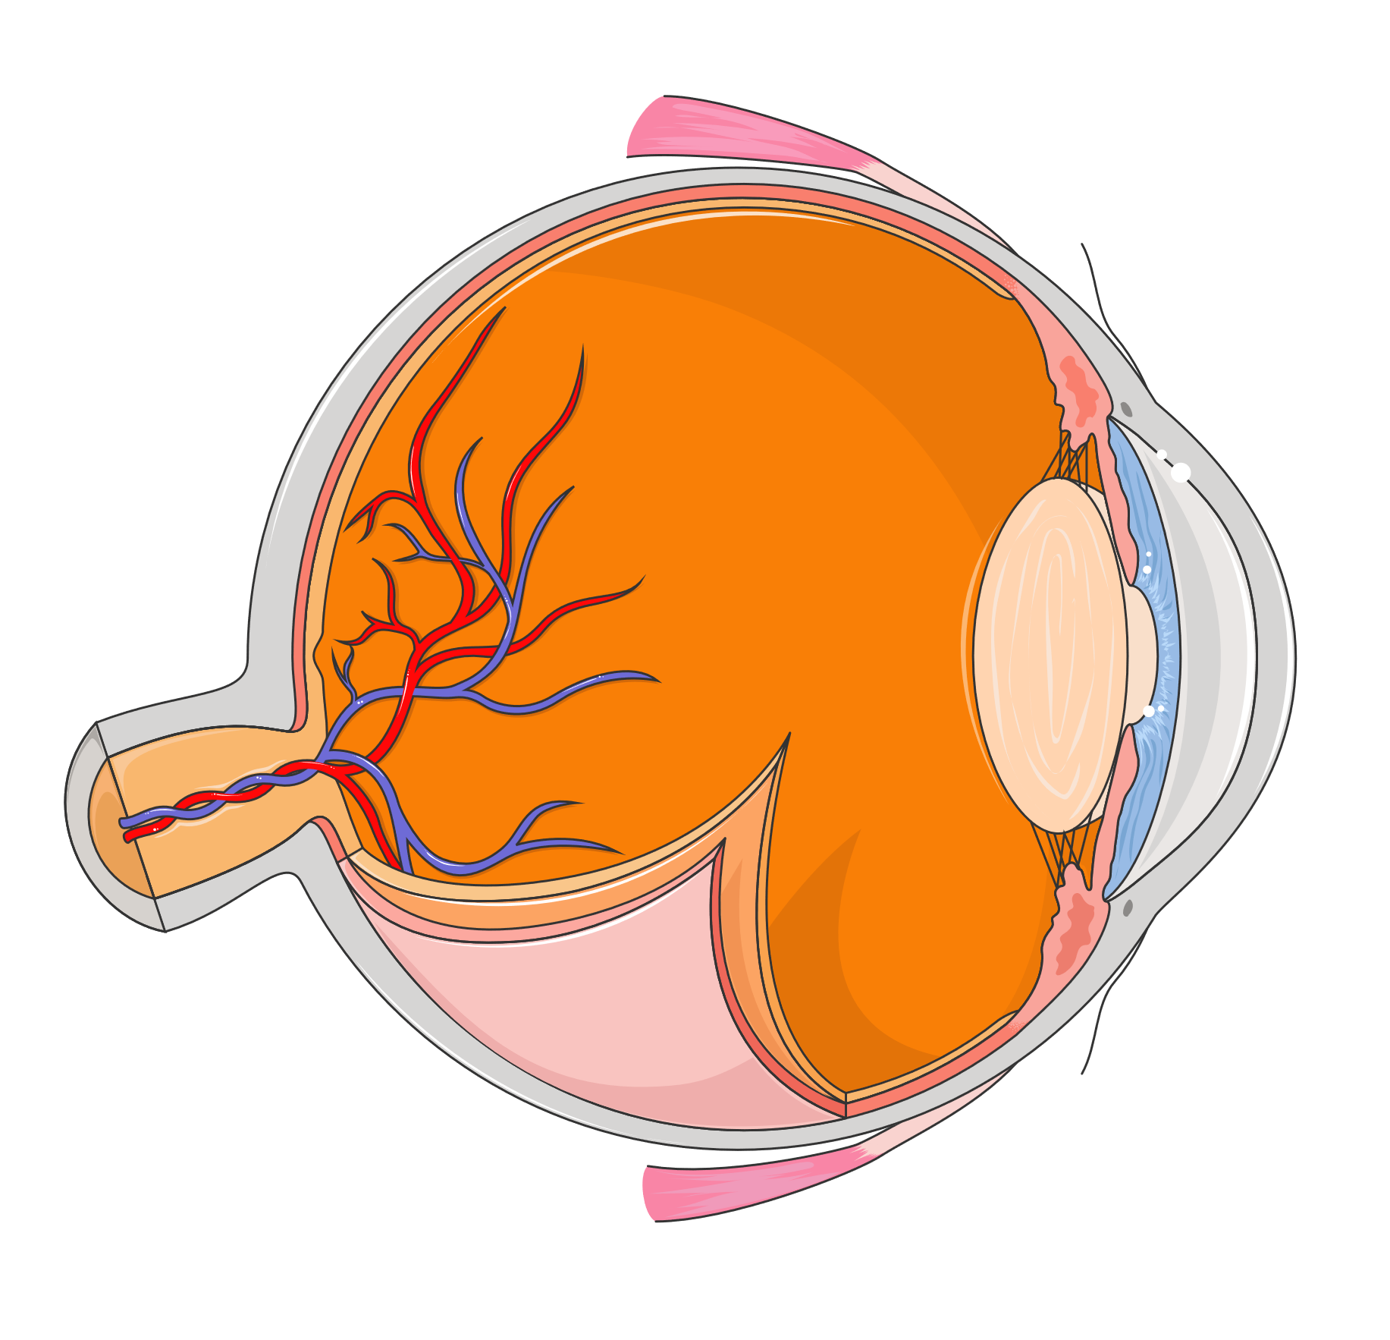
VISUAL SYSTEM
The visual system captures light from the environment and converts it into electrical signals, which are then interpreted by the brain to produce images, enabling the perception of color, shape, depth, and movement.
VITREOUS HUMOR
CANAL OF SCHLEMM
MACULA
CORNEA
OPTIC NERVE
IRIS
RETINAL BLOOD VESSELS
PUPIL
LENS
SCLERA
CHOROID
RETINA

