Slide 1
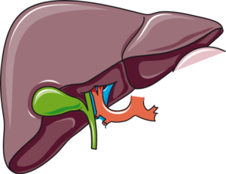
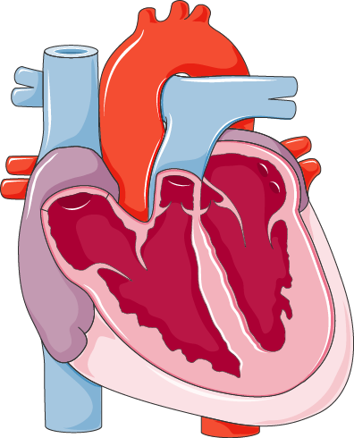
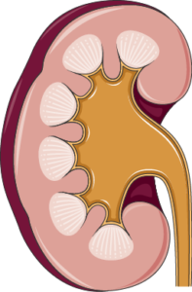
DIABETES
SGLT-2 INHIBITORS
SGLT2 inhibitors play a crucial role in managing type 2 diabetes. They block the SGLT2 protein in the kidneys, reducing glucose reabsorption into the blood and increasing its excretion in the urine. This helps lower blood sugar levels. Additionally, they have shown benefits for patients with heart failure.
SGLT-2 INHIBITION
GLUCOSURIA
↗ HEPATIC GLUCOSE OUTPUT
↘ BLOOD PRESSURE
↘ STEATOSIS
↘ HEART FAILURE
NATRIURESIS
RENOPROTECTION
B-CELL PRESERVATION
↗ LIPOLYSIS
↘ FAT MASS
↗ GLUCAGON
↘ INSULIN

