Slide 1
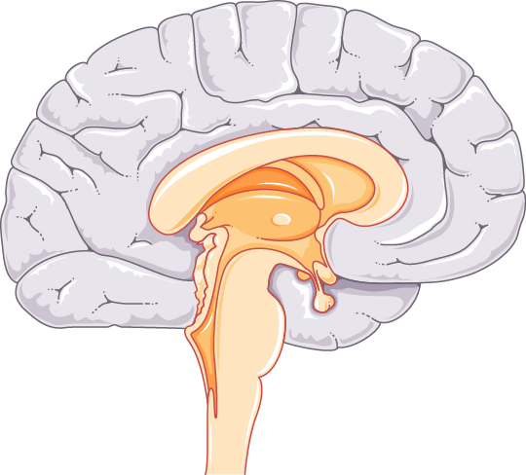
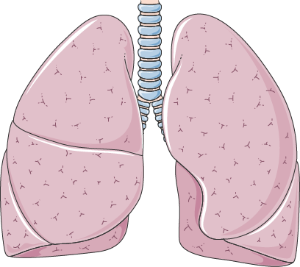
Endocrine System Overview Female and Male
This chart highlights the main endocrine glands in male and female silhouettes, from brain to gonads, offering a clear overview of hormone-producing organs and their locations.
PINEAL GLAND
HYPOTHALAMUS
PITUITARY GLAND
PARATHYROID GLANDS
THYROID GLAND
THYMUS
ADRENAL GLANDS
PANCREAS
KIDNEYS
OVARIES
TESTES

