Slide 2
Emergency Equipment

Slide 3
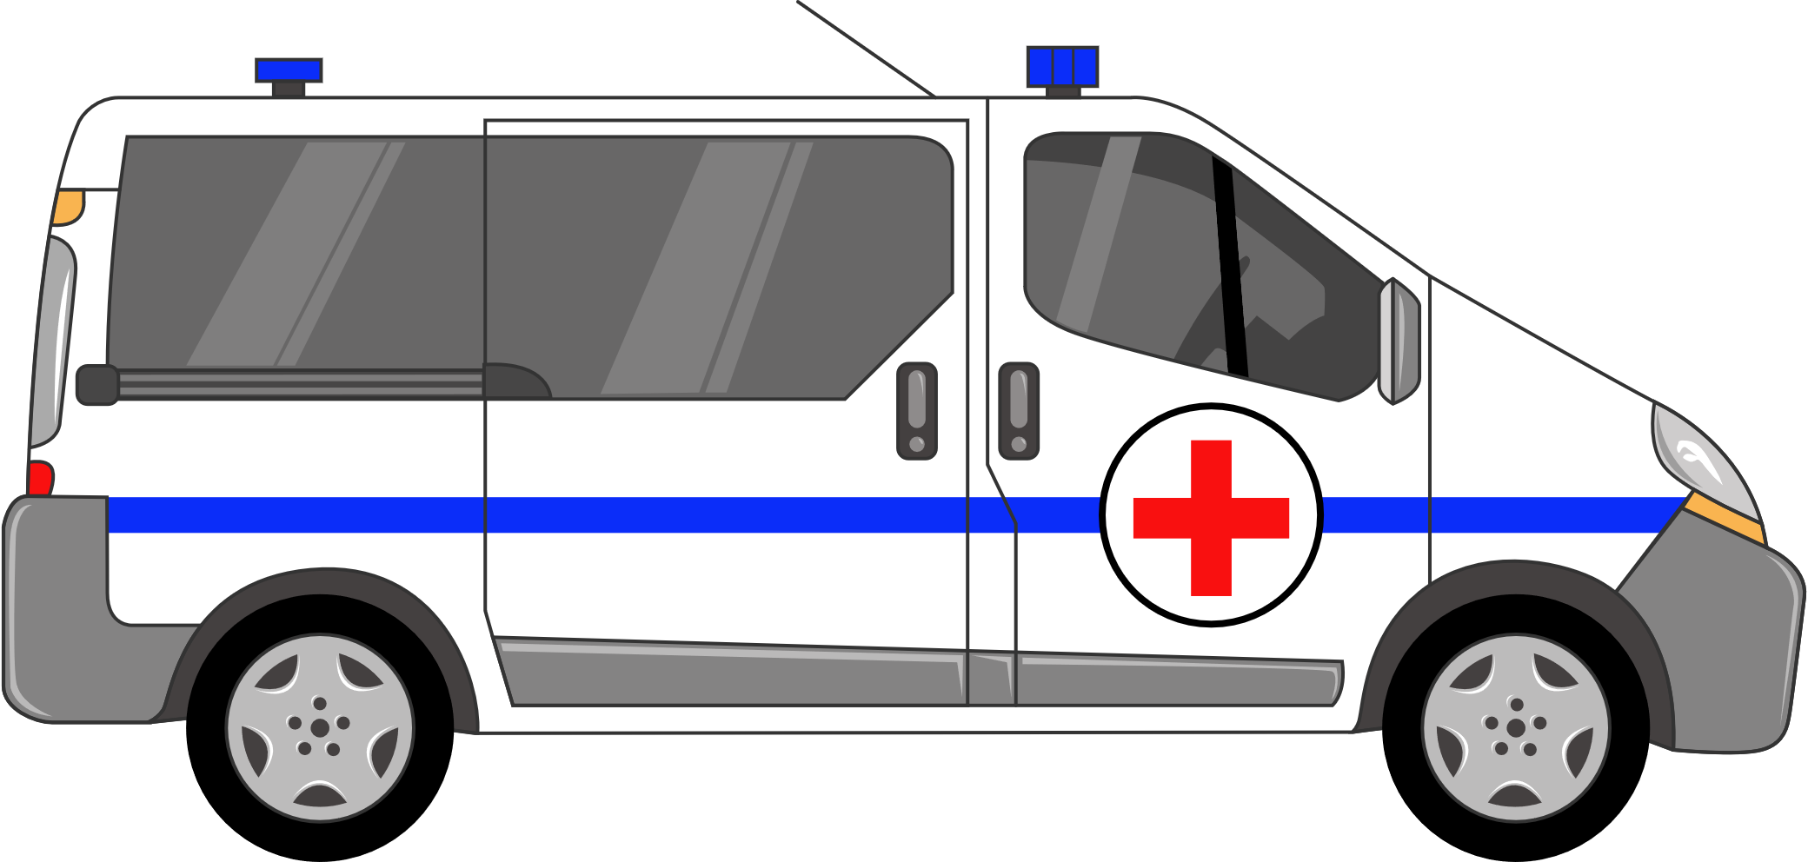
Ambulance

Slide 4
Helicopter

Slide 5
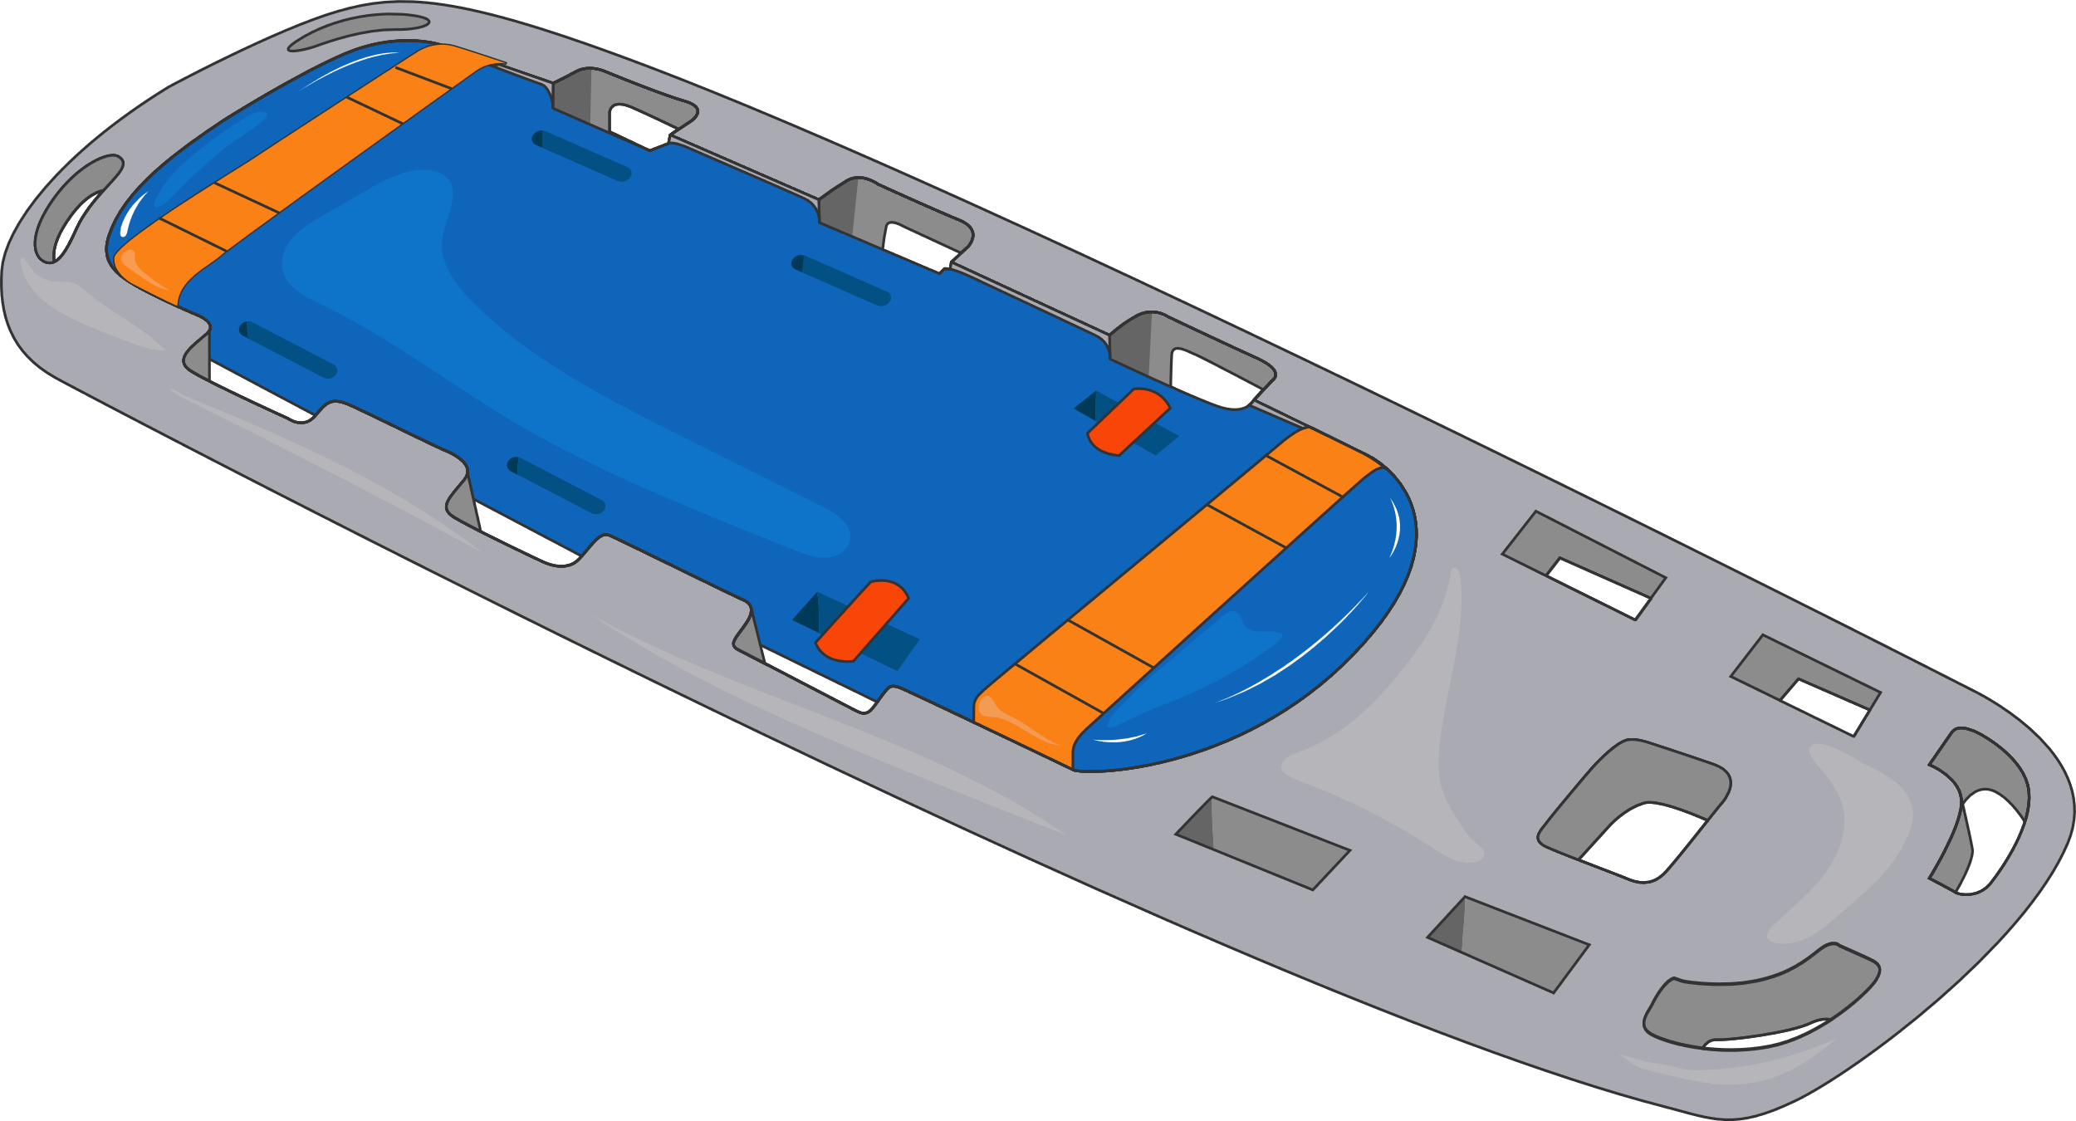
Stretcher

Slide 6
Emergency kit / bag

