Slide 1
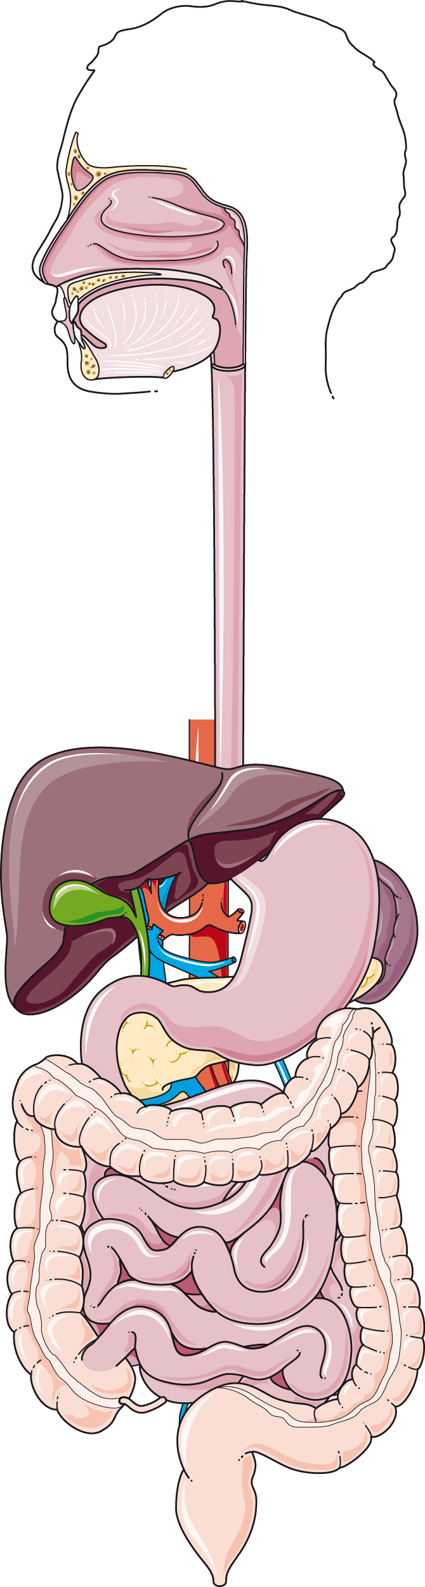
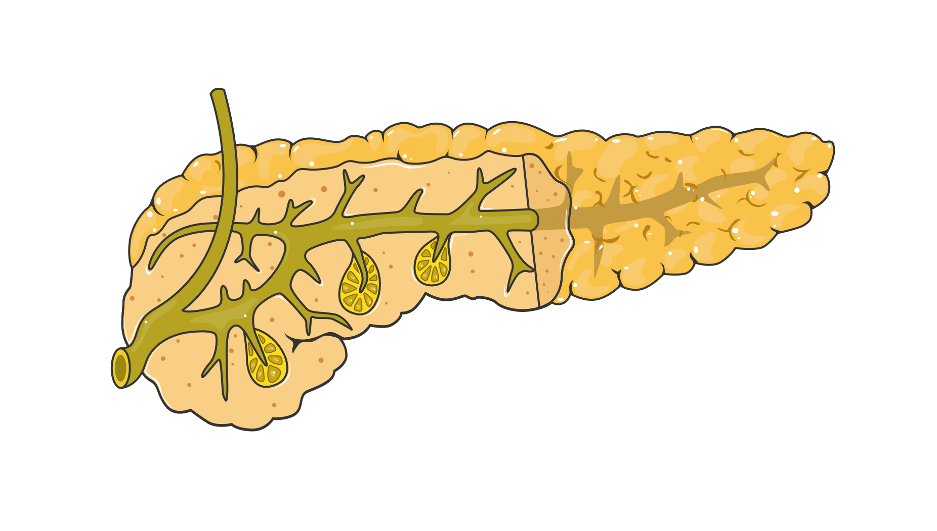
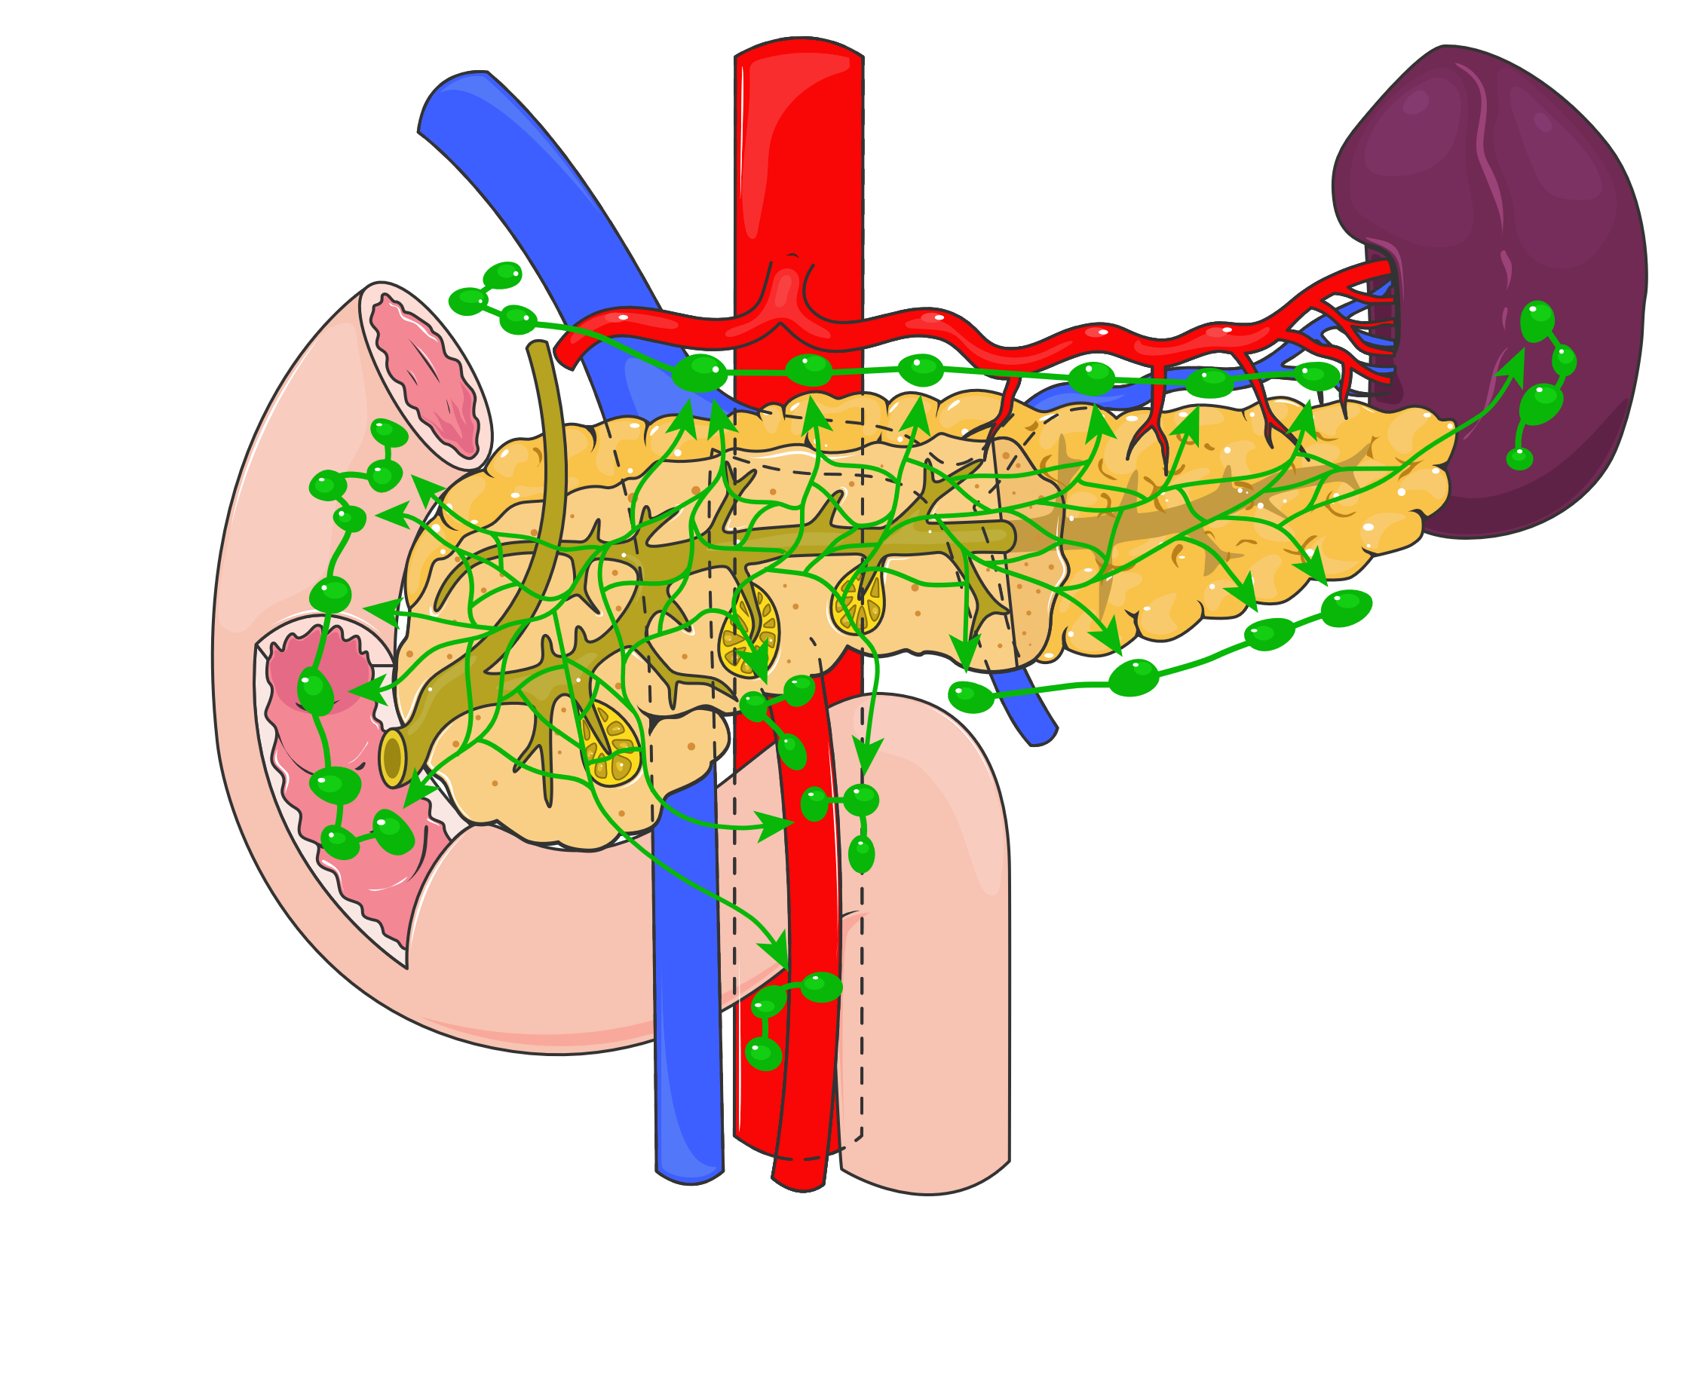
Pancreas and Surrounding Organs
This chart illustrates the pancreas, its dual role in digestion and hormone regulation, and its close anatomical relationships with the duodenum, spleen, and surrounding lymphatic drainage.
Pancreas
Aorta
Portal vein
Spleen
Splenic artery
Tail
Body
Duodenum
Head
Bile duct
Pancreatic duct
Endocrine cells:
β-cells → Insulin
α-cells → Glucagon
δ-cells → Somatostatin
γ-cells → PolyPeptide
ε-cells → Ghrelin
Lymphatic drainage
Exocrine cells
Macrophages
Endothelium
Islet of Langerhans
Superior mesenteric vein and artery
Digestive system

